Slide 1
After completing this unit you will be able to :
MODULE: Requisitions and Reporting (Nominal)
FOR COMPLETION OF THE NOMINAL TEST FORM
Accurately complete the form that you will submit to the Public Health Ontario Laboratories (PHOL) for HIV rapid POC test results and additional HIV testing requests
Use the stickers provided by the Ministry of Health to notify PHOL of HIV rapid testing results and request additional testing
Complete the daily testing log to maintain the quality of testing at your site
Notes:
Review the learning objective with the trainees

Slide 2

Record Keeping is Essential
MODULE: Requisitions and Reporting (Nominal)
Every time you do an POC HIV test for a client, you MUST:
Complete an HIV Serology Requisition form. These can be downloaded from https://www.publichealthontario.ca/
Make a log entry for the test on your site’s daily log
These record-keeping steps are essential to provide accurate results for your clients and to maintain quality standards at your testing site.
  Errors in this record keeping would be an incident that requires an investigation at your site. Ultimately effective record-keeping is necessary to maintain approval for testing at your site.

Slide 3
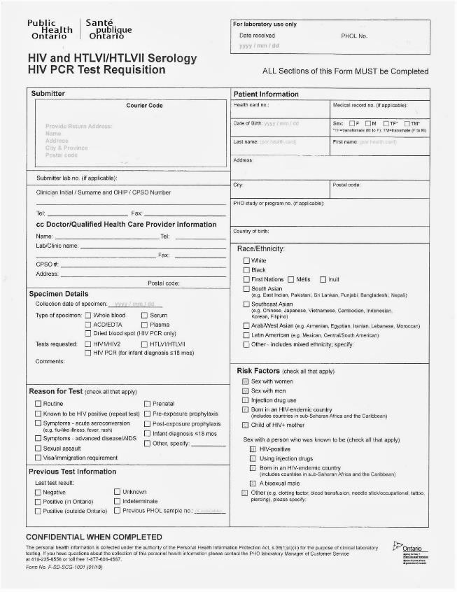
HIV Serology Requisition
MODULE: Requisitions and Reporting (Nominal)
This form is used when a client is requesting:
Rapid POC testing done at your site
Laboratory testing from the Public Health Ontario Laboratory (PHOL)
Whenever you do a valid POC test, you must submit a form to PHOL. Be sure to complete the form and all of its fields in full.
You only submit ONE form for each client, even if you are reporting a POC test result and requesting a follow-up test for confirmation or further window period screening.

Slide 4


Anonymized forms
MODULE: Requisitions and Reporting (Nominal)
In this module, we will discuss several scenarios that may occur when
submitting a serology form to PHOL. Sometimes you will submit a form, but not a sample. This happens when:
  You did a POC test and it was nonreactive; there is no reason to request further follow-up testing
  There is a reason to recommend follow-up testing, but your client does not consent to submit a specimen to PHOL
In these circumstances, your client should not be identified to PHOL, and information like the client’s name and date of birth should be excluded from the form (an anonymized form). However you must still submit a record of the test and information about the reason for the test and the client’s risk factors.

Slide 5

Workflow and the Serology Requisition
MODULE: Requisitions and Reporting (Nominal)
Complete all sections as fully as possible.
Complete the sections:
  Reason for testing
  Previous testing information
  Race/Ethnicity
  Risk factors
  …while speaking with your client, during the HIV testing counselling appointment
Do not complete the patient information section of the form until POC testing is complete.
The outcomes of the POC testing will determine whether or not you need to anonymize this information.

Slide 6
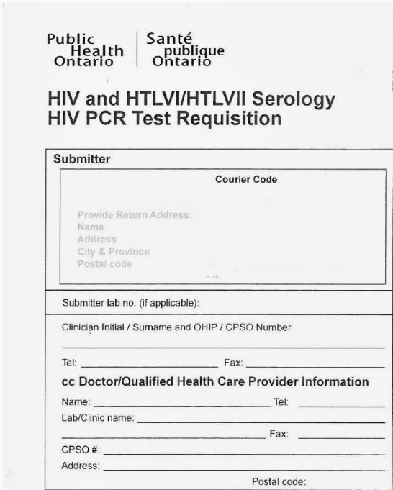
The Serology Requisition
MODULE: Requisitions and Reporting (Nominal)
Your clinic will most often have pre-printed HIV Serology forms with this portion complete.
If you need to complete it by hand, the doctor’s name is the person who holds your site’s medical directive and their CPSO# is used.
Where do you get forms when you need them (or more when you run out)? Ask about the practice at your site.

Slide 7
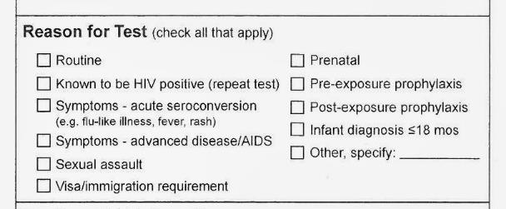
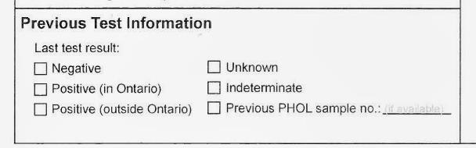
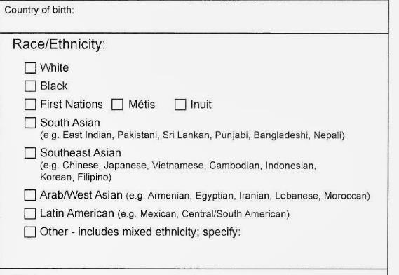
Required Fields
MODULE: Requisitions and Reporting (Nominal)
x
Most tests will be routine – although you may identify additional reasons for testing, such as sexual assault or symptoms of acute HIV infection, when speaking with the client.
Complete this section based on your site’s records of this client OR what the client tells you about their history.
This information is often collected on your site’s intake form. Some sites are able to print this information from their electric medical record as part of the patient identification sticker.

Slide 8
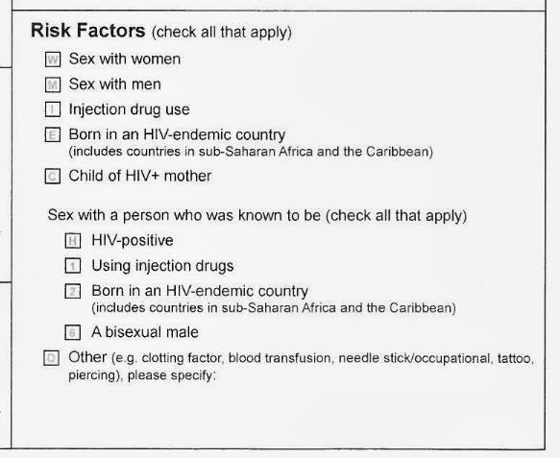
Required Fields
MODULE: Requisitions and Reporting (Nominal)
Collected during your risk assessment of the client
All required sections of the form are important for provincial planners to understand where more HIV prevention and care services are needed. They are not used to “track” individual patients.
Notes:
Stress the value of complete information in these fields

Slide 9
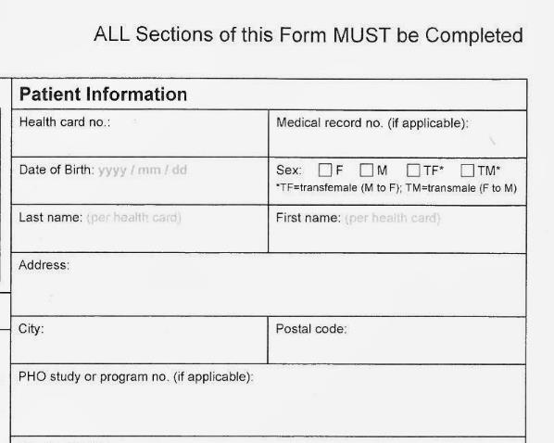
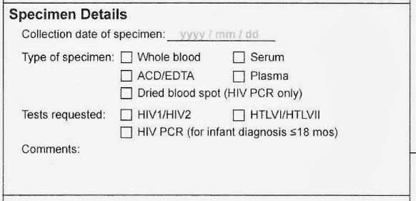
When Submitting a Sample
MODULE: Requisitions and Reporting (Nominal)
Do not complete the patient information section of the form until POC testing is complete.
Be careful to enter the client’s OHIP card number correctly and their full date of birth. This information is used by Public Health units to follow-up with clients for contact tracing.
Make sure that the specimen details are complete. The tube of blood and the form must have the date you drew the blood. Both this date and the person’s name must MATCH.
You will usually be submitting serum (red top tube) and requesting a HIV1/HIV2 test
X
X

Slide 10
When NOT Submitting a Sample
MODULE: Requisitions and Reporting (Nominal)
If only POC testing was done, the patient information should be limited. If you are not submitting a sample to PHOL:
Only put the client’s year of birth on the form
Don’t use the client’s name, use an identification code
Suggested code
If you saw Jack Smith on July 3, 2019, the code could be:
JS-03072019
Your site will order stickers from the Ministry to flag forms that are not submitted with samples. We will review the sticker system, as we review possible testing scenarios.

Slide 11
Testing Scenarios
MODULE: Requisitions and Reporting (Nominal)
Here are some scenarios you will encounter when testing clients :
Your client requests standard testing (You did not do a rapid test.)
You perform a rapid POC test - it is non-reactive and outside the window period.
You perform a rapid POC test and it is non-reactive. However, the client is from a priority population, has had a very recent high risk exposure (in the last 2-4 weeks or with current signs of acute HIV infection).
You perform a rapid POC test and it is reactive.
Your client has two invalid POC tests, and you are submitting a sample for testing.
Notes:
Reassure the trainees, you will be walking through each of these scenarios.

Slide 12


1) Standard Testing
MODULE: Requisitions and Reporting (Nominal)
Some of your clients will choose to have a standard HIV test instead of a rapid test. After counselling and consent:
Draw and label a tube of blood (red top tube)
Complete the form fully, including the client’s name and OHIP#
Ensure that the name and date on the sample matches the name and date on the form.
No Sticker necessary
Submit the tube and requisition; enter the test on the daily log if this is the practice at your site.
Book an appointment in approximately one week for the client to return for their result.
Notes:
When training staff, remind them that it is the clients who choose which testing method they prefer. The client can choose standard lab testing, rather than rapid/POC, if that is their preference or better meets their concerns.

Slide 13

2) A Non-reactive POC Test
MODULE: Requisitions and Reporting (Nominal)
X
After counselling and consent:
You perform a POC test; it is non-reactive and the client is not in the window period
Complete the patient information section using a code (not the client’s name) and their year of birth; attach a GREEN “non-reactive” sticker
Submit the requisition and enter this test on the daily log
Anon
Complete post-test counselling. Advise client about further testing (follow-up testing on a high risk exposure or routine testing.)
NOTE: PHOL will issue a standard report for this submission, it can be discarded.

Slide 14

3) A Non-Reactive Window Period Test
MODULE: Requisitions and Reporting (Nominal)
After counselling and consent, you determine that:
The client is from a priority population and has had a very recent high risk exposure (in the last 2-4 weeks or with signs of acute HIV infection).
Perform a POC test; it is non-reactive
Recommend the client submit a standard test for p24 testing; if the client agrees, draw blood
Complete the form fully, including the client’s name and OHIP#; attach a YELLOW “non-reactive window period” sticker; ensure the name/date on the sample matches the name/date on the form
Submit the requisition; enter the test on the daily log
Complete post-test counselling. Book an appointment in one week to share results.

Slide 15

4) A Reactive POC Test
MODULE: Requisitions and Reporting (Nominal)
After counselling and consent:
Perform a POC test; it is reactive
Recommend client submit a standard test to confirm this result; if the client agrees, draw blood
Complete the form fully, including the client’s name and OHIP#; attach a PINK “reactive” sticker. Ensure the name/date on the sample matches the name/date on the form
Submit the requisition; enter the test on the daily log
Complete post-test counselling. Book an appointment in one week to confirm result.

Slide 16
5) Two repeated Invalid tests
MODULE: Requisitions and Reporting (Nominal)
After counselling and consent:
Perform a POC test; it is invalid. Repeat the test once; ensure a sufficient sample of blood. If is invalid again, don’t throw out the test membranes.
If TWO invalid tests have occurred, ask the client if you can draw blood for standard testing. Be reassuring, an invalid result, is not caused by the presence of HIV. It can have many underlying causes (most commonly adding too little sample to the test.)
If the client agrees, draw blood (red top) for testing. Ensure the form is completed fully for standard testing; no sticker is needed. If the client declines standard testing, DO NOT SUBMIT A FORM as a valid test did not occur.
Enter the record of both POC and standard tests on the daily log as well as an entry in the incident log for the invalid tests. Take a picture of the invalid membranes and notify the AIDS Bureau about the invalid tests.
No Sticker
necessary
Complete post-test counselling. Book an appointment in one week for results.
Notes:
Talk about any other details of how your clinic responses to invalid tests. Should the QA lead be notified? Where should they store the membrane while awaiting further investigation? Who sends the photo to the AIDS Bureau?

Slide 17

Forms without Samples – What Sticker do I use?
MODULE: Requisitions and Reporting (Nominal)
The purpose of the priority stickers is to clarify for PHOL staff what further actions to take. When you submit a form to PHOL but NOT a blood sample, you need to make it clear that a sample has not been lost.
Forms without samples should be anonymized (no name or date of birth; use code/year of birth only)
The most usual “no sample” situation is a nonreactive test , where the client is not in the window period, and no further testing is needed. Use the GREEN sticker.
In other circumstances, this white sticker is added in addition to another sticker, to make it clear that a sample is intentionally absent:
  Client had a reactive POC test and declined blood draw (PINK + WHITE)
  Priority population client, had a very recent high risk exposure (3-4 weeks) and declined a blood draw (YELLOW + WHITE)
  Priority population client, testing six weeks after a very high risk exposure (YELLOW + WHITE)
  Client is NOT from a priority population and is in the window period, but has been deferred from blood draw (GREEN + WHITE)
blood sample
not included
Notes:
A chart is available which details when to add two stickers to the form.

Slide 18
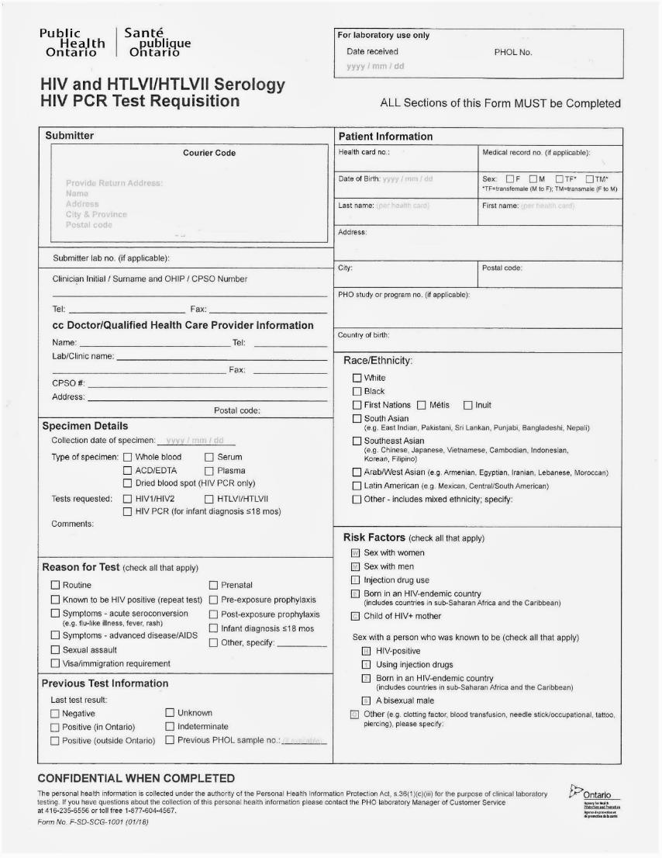

Summary
HIV Serology Requisition
MODULE: Requisitions and Reporting (Nominal)
Complete the form – for all POC tests add the appropriate sticker
Put second white sticker here if needed
Client declined blood sample
Client declined blood sample

Slide 19
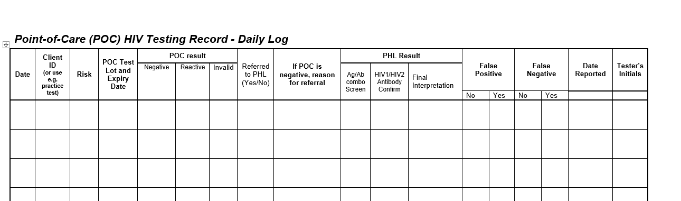
The Daily Log
MODULE: Requisitions and Reporting (Nominal)
This is a screen shot of the daily log template. An entry must be made for every test you do.
Make sure you sign and date each entry.
This part of the log is used to make a record of any POC test.
This part of the log is used for follow-up of tests sent to PHOL and analysis of the returned results.
Notes:
Make sure the trainee knows where the daily log is an how to get replacement sheets
Explain who fills in results returning from PHOL (Is that a counsellor’s responsibility?) and what to do if they observe a discrepancy.

Slide 20
The Daily Log – Record of a POC Test
MODULE: Requisitions and Reporting (Nominal)
Write the result in one of these three fields.
If sending a sample to PHOL say yes in the last field, shown here.
Use these four fields for every test you do:
When you did the test
Who you did the test for (most commonly a client name/number)
The risk factors (usually abbreviated i.e. MSM, ACB, PWID, etc.)
The lot number and expiry date of the kit you used
For Proficiency Tests, practice testing, or errors/damage, write what the test was used for across these fields

Slide 21
The Daily Log – Record of a Sample Sent to PHOL
MODULE: Requisitions and Reporting (Nominal)
Date and sign.
Say yes if a sample is sent to PHOL
Record differences between POC and PHOL results. These fields may be completed by the Quality Assurance Lead at your site when preparing the monthly summary report. Ask about the practice at your site.
Most commonly you will do this if the client is testing early in the window period
Use the results that return to you from PHOL (1 week) to complete these fields.
Notes:
NOTE: If a sample is NOT submitted to the PHOL and a WHITE sticker is used on the requisition form (e.g., the client is not “nonreactive and outside the window period”), use the PHOL fields to explain why a sample was not submitted.

Slide 22
The Daily Log
MODULE: Requisitions and Reporting (Nominal)
Record keeping in the Daily Log matters because:
It lets you track what has been sent to PHOL for testing, to ensure all sent samples have a result returned
It helps track the number of test kits used at your site, a total required when ordering new kits through the Inventory Management portal (www.hivpoct.ca)
The log assists with quality assurance at your site, helping to identify any discrepancies between the POC test results you record and PHOL findings

