Slide 1
After completing this unit you will be able to:
MODULE: Requisitions and Reporting (Anonymous)
FOR COMPLETION OF THE ANONYMOUS TEST FORM
Accurately complete the form that you will submit to the Public Health Ontario Laboratories (PHOL) for HIV rapid POC test results and additional HIV testing requests
Use the stickers provided by the Ministry of Health to notify PHOL of HIV rapid testing results and request additional testing
Complete the daily testing log to maintain the quality of testing at your site
Use the logs to find the results of a client who has misplaced their tracking number
Notes:
Review the learning objective with the trainees

Slide 2

Record Keeping is Essential
MODULE: Requisitions and Reporting (Anonymous)
Every time you do a POC HIV test for a client, you MUST:
Complete an Anonymous HIV Serology Requisition form
Make a log entry for the test on your site’s daily log
Create a take-home card for the client with their anonymous identification number
These record-keeping steps are essential to provide accurate results for your clients and to maintain quality standards at your testing site.
  Errors in this record keeping would be an incident that requires an investigation at your site. Ultimately effective record-keeping is necessary to maintain approval for testing at your site.

Slide 3
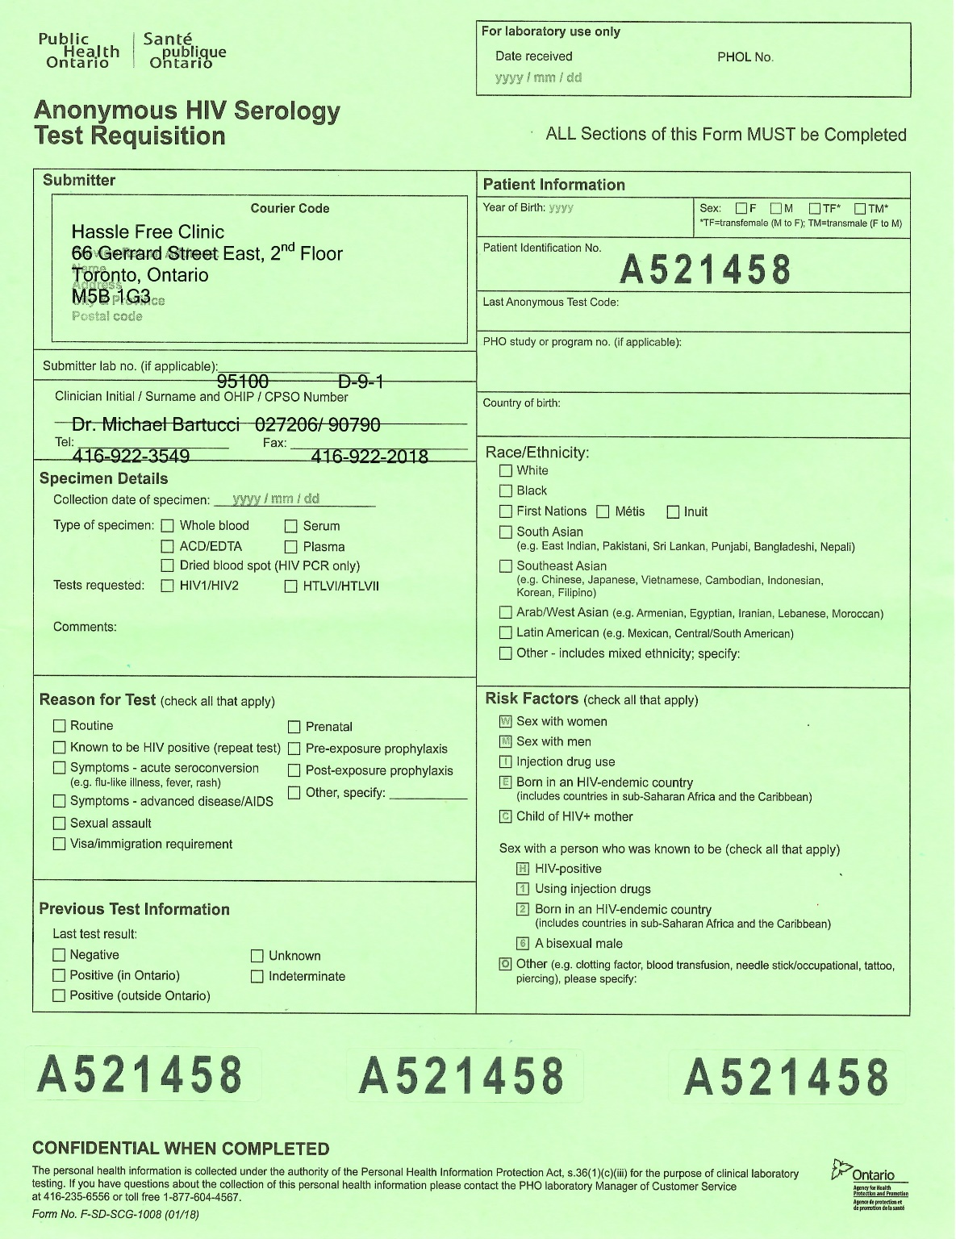
Anonymous HIV Serology Requisition
MODULE: Requisitions and Reporting (Anonymous)
This form is used ONLY BY DESIGNATED ANONYMOUS TEST SITES.
This is the only form that should be used when the client is requesting anonymous testing including:
Rapid POC testing done at your site
Laboratory testing from the Public Health Ontario Laboratory (PHOL)
Whenever you do a valid POC test, you must submit a form to PHOL. Be sure to complete the form and all of its fields in full.
You only submit ONE form for each client, even if you are reporting a POC test result and requesting a follow-up test for confirmation or further window period screening.

Slide 4
Anonymous HIV Serology Requisition
MODULE: Requisitions and Reporting (Anonymous)
Your clinic will most often have pre-printed forms with this portion complete.
If you need to complete it by hand, the doctor’s name is the person who holds your site’s medical directive and their CPSO# is used.
Where do you get forms when you need them (or more when you run out)? Ask about the practice at your site.

Slide 5
Labelling and Anonymous Requisitions
MODULE: Requisitions and Reporting (Anonymous)
When using this form, the large numbers at the bottom are an important part of the process. They maintain the client’s anonymity while ensuring the client gets accurate results:
Remove the peel-off sticker numbers. Use:
One to label the blood sample (if submitting)
One to label the POC testing membrane (if doing a POC test)
One on the client’s take home card
The number of the blood sample and the requisition must match or the lab will not process the specimen. Both the form and the sample must also have the date you collected this sample.
A client record folder should also be created using this number, and stored separately from any other records this client may have.
Notes:
Clarify any variations on this used at your site. Some sites do not label the membrane because they do the test in front of the client. These sites may use the extra number in or on the patient file.

Slide 6
Required Fields
MODULE: Requisitions and Reporting (Anonymous)
Relatively little patient information needs to be included in the patient information section:
Client’s year of birth (no month or day)
Client’s sex
Ask the client if they have an anonymous testing code from a previous testing experience at your clinic. If so, it is helpful to add this number to the record, so your site and the Ministry can better understand, whether or not clients are testing routinely.

Slide 7
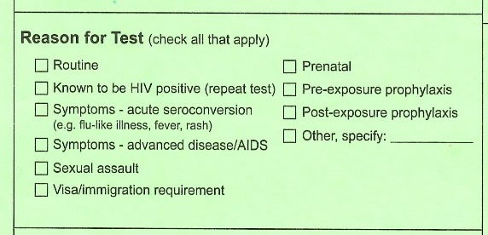
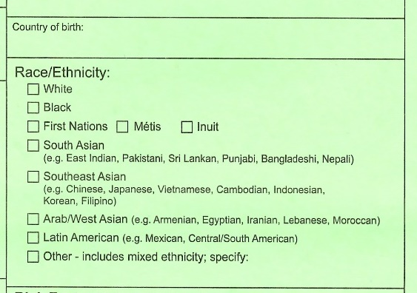
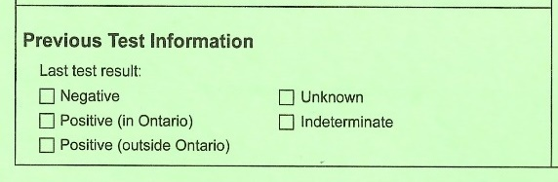
Required Fields
MODULE: Requisitions and Reporting (Anonymous)
x
Most tests will be routine – although you may identify additional reasons for testing, such as sexual assault or symptoms of acute HIV infection, when speaking with the client.
Complete this section based on your site’s records of this client OR what the client tells you about their history.
This information is often collected on your site’s intake form.

Slide 8
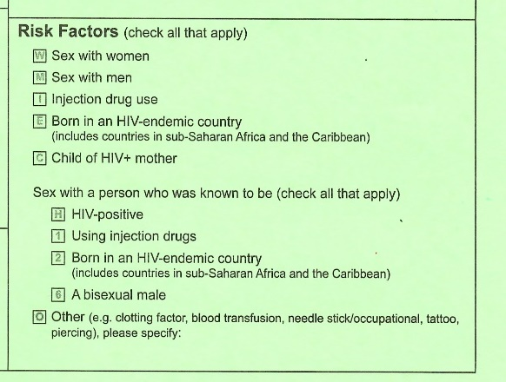
Required Fields
MODULE: Requisitions and Reporting (Anonymous)
Collected during your risk assessment of the client
All required sections of the form are important for provincial planners to understand where more HIV prevention and care services are needed. They are not used to “track” individual patients.
Notes:
Stress the value of complete information in these fields

Slide 9
When Submitting a Sample
MODULE: Requisitions and Reporting (Anonymous)
When doing follow-up standard testing on a POC test, or when submitting standard testing early in the window period, complete the specimen details:
Make sure you add the date of the test
You will usually be submitting serum (red top tube) and requesting an HIV1/HIV2 test.
Make sure the client has their take home card with the peel-off ID number attached. This is how you will identify their results when they return.
X
X

Slide 10

Lost ID Numbers
MODULE: Requisitions and Reporting (Anonymous)
If an ID number is lost:
Encourage the client to return for their results, even if they lose their card and number.
You can use the daily log on the day they came in and look up anonymous files listed to see if the information and risk factors match the client.
Clients concerned about losing their number can give you a code word to add to this anonymous file, so that when you look it up you know you have found the correct file!

Slide 11


Testing Scenarios
MODULE: Requisitions and Reporting (Anonymous)
Here are some scenarios you will encounter when testing clients:
Your client requests standard testing (You did not do a rapid test.)
You perform a rapid POC test and it is non-reactive and outside the window period.
You perform a rapid POC test and it is non-reactive. However, the client is from a priority population, and has had a very recent high risk exposure (either in the last 2-4 weeks or with current signs of acute HIV infection).
You perform a rapid POC test and it is reactive.
Your client has two invalid POC tests, and you are submitting a sample for testing.
Notes:
Reassure the trainees, you will be walking through each of these scenarios.

Slide 12


1) Standard Testing
MODULE: Requisitions and Reporting (Anonymous)
Some of your clients will choose to have a standard HIV test instead of a rapid test. After counselling and consent:
Draw and label a tube of blood (red top tube)
Complete the form fully
Ensure that the ID code and date on the sample matches the ID code and date on the form (two matching identifiers are required on the sample and form)
No Sticker necessary
Submit the tube and requisition; enter the record of this test on the daily log.
Book an appointment in approximately one week for the client to return for their result.
Notes:
When training staff, remind them that if your site offers both anonymous and standard/nominal testing, it is the clients who choose which testing method they prefer. In either situation, clients can choose the rapid/POC test. So, rapid testing can be offered anonymously or nominally, it’s up to the client to choose. They can also choose standard lab testing, rather than rapid/POC, and again either anonymously or nominally. The ministry does not require that all anonymous tests be done using rapid/POC tests, or that all rapid/POC tests be done anonymously.

Slide 13
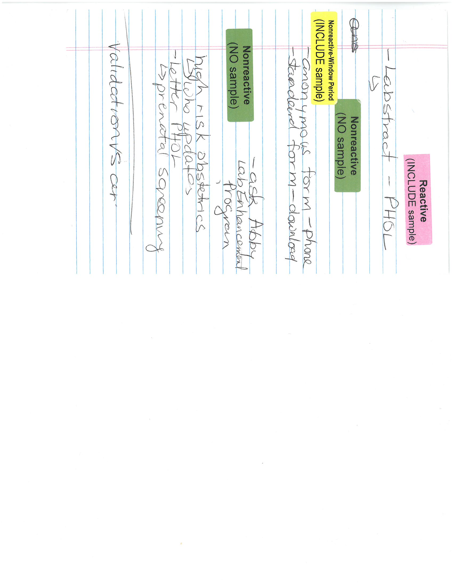
2) A Non-reactive POC Test
MODULE: Requisitions and Reporting (Anonymous)
X
After counselling and consent:
You perform a POC test; it is non-reactive and the client is not in the window period
Complete the form fully; attach a GREEN non-reactive sticker
Submit the requisition; enter the record of this test on the daily log
Complete post-test counselling with the client. Advise client about further testing (follow-up on a high risk exposure or routine testing.)
NOTE: PHOL report will be issued for this submission, it can be discarded.

Slide 14
3) A Non-Reactive Window Period Test
MODULE: Requisitions and Reporting (Anonymous)
After counselling and consent, you determine that:
The client is from a priority population and has had a very recent high risk exposure (in the last 2-4 weeks or with signs of acute HIV infection).
Perform a POC test; it is non-reactive
Recommend the client submit a standard test for p24 testing; if the client agrees, draw blood
Complete the form fully; attach a YELLOW “non-reactive window period” sticker. Ensure that the ID#/date on the sample matches the ID#/date on the form.
Submit the requisition; enter the test on the daily log.
Complete post-test counselling. Book an appointment in one week to share results.

Slide 15
4) A Reactive POC Test
MODULE: Requisitions and Reporting (Anonymous)
After counselling and consent, you:
Perform a POC test; it is reactive
Recommend client submit a standard test to confirm this result; if the client agrees, draw blood
Complete the form fully; attach a PINK reactive sticker. Ensure that the ID#/date on the sample matches the ID#/date on the form.
Submit the requisition; enter test on the daily log.
Complete post-test counselling. Book an appointment in one week to confirm result.

Slide 16
5) Two repeated Invalid tests
MODULE: Requisitions and Reporting (Anonymous)
After counselling and consent:
Perform a POC test; it is invalid. Repeat the test once; ensure a sufficient sample of blood. If is invalid again, don’t throw out the test membranes.
If TWO invalid tests have occurred, ask the client if you can draw blood for standard testing. Be reassuring, an invalid result, is not caused by the presence of HIV. It can have many underlying causes (most commonly adding too little sample to the test.)
If the client agrees, draw a tube of blood (red top tube). Ensure the form is completed fully for standard testing; no sticker is needed. If the client declines standard testing, DO NOT SUBMIT A FORM as a valid test did not occur.
Enter the record of both POC and standard tests on the daily log as well as an entry in the incident log for the invalid tests. Take a picture of the invalid membranes and notify the AIDS Bureau about the invalid tests.
No Sticker
necessary
Complete post-test counselling. Book an appointment in one week for results.
Notes:
Talk about any other details of how your clinic responses to invalid tests. Should the QA lead be notified? Where should they store the membrane while awaiting further investigation? Who sends the photo to the AIDS Bureau?

Slide 17
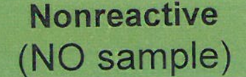
Forms without Samples – What Sticker do I use?
MODULE: Requisitions and Reporting (Anonymous)
The purpose of the priority stickers is to clarify for PHOL staff what further actions to take. When you submit a form to PHOL but NOT a blood sample, you need to make it clear that a sample has not been lost.
The most usual “no sample” situation is a nonreactive test , where the client is not in the window period, and no further testing is needed. Use the GREEN sticker.
In other circumstances, this white sticker is added in addition to another sticker, to make it clear that a sample is intentionally absent:
  Client had a reactive POC test and declined blood draw (PINK + WHITE)
  Priority population client, had a very recent high risk exposure (3-4 weeks) and declined a blood draw (YELLOW + WHITE)
  Priority population client, testing six weeks after a very high risk exposure (YELLOW + WHITE)
  Client is NOT from a priority population and is in the window period, but has been deferred from blood draw (GREEN + WHITE)
blood sample
not included
Notes:
A chart is available which details when to add two stickers to the form.

Slide 18
Summary
Anonymous HIV Serology Requisition
MODULE: Requisitions and Reporting (Nominal)
Complete the form for all POC tests add the appropriate sticker
Put second white sticker here if needed
Client declined blood sample
Client declined blood sample

Slide 19

Storing Anonymous Tests and Files
MODULE: Requisitions and Reporting (Anonymous)
Although many anonymous HIV testing sites do other forms of testing, designated sites must have separate record-keeping for anonymous HIV results:
A person’s anonymous testing number should never be stored in a nominal file that may be maintained for STI or other testing.
Anonymous testing records must be kept for up to 10 years.
If a person testing anonymously has a positive test, their physician may want them to test nominally (using their name) when they enter care.

Slide 20
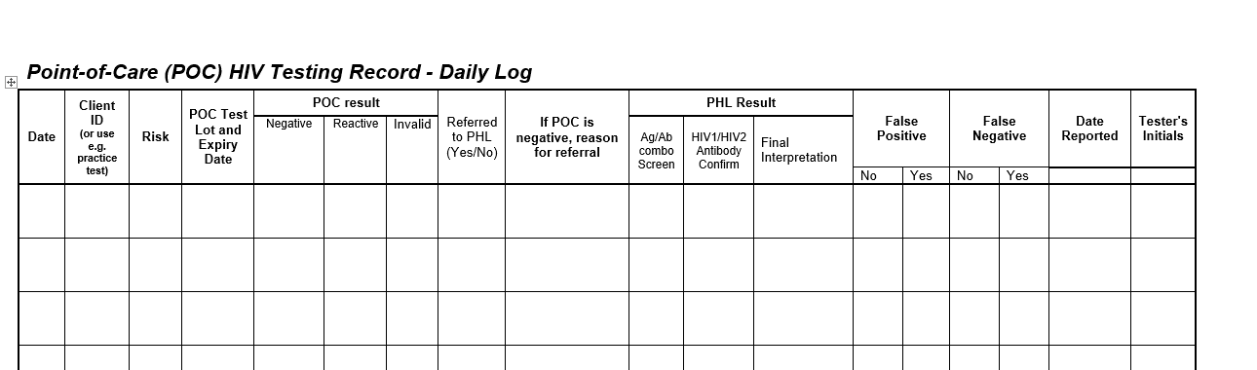
The Daily Log
MODULE: Requisitions and Reporting (Anonymous)
This is a screen shot of the daily log template. An entry must be made for every test you do.
Make sure you sign and date each entry.
This part of the log is used to make a record of any POC test.
This part of the log is used for follow-up of tests sent to PHOL and analysis of the returned results.
Notes:
Make sure the trainee knows where the daily log is an how to get replacement sheets
Explain who fills in results returning from PHOL (Is that a counsellor’s responsibility?) and what to do if they observe a discrepancy.

Slide 21
The Daily Log – Record of a POC Test
MODULE: Requisitions and Reporting (Anonymous)
Write the result in one of these three fields.
If sending a sample to PHOL say yes in the last field, shown here.
Use these four fields for every test you do:
When you did the test
Who you did the test for (anonymous testing number)
The risk factors (usually abbreviated i.e. MSM, ACB, PWID, etc.)
The lot number and expiry date of the kit you used
For Proficiency Tests, practice testing, or errors/damage, write what the test was used for across these fields

Slide 22
The Daily Log – Record of a Sample Sent to PHOL
MODULE: Requisitions and Reporting (Anonymous)
Date and sign.
Say yes if a sample is sent to PHOL
Record differences between POC and PHOL results. These fields may be completed by the Quality Assurance Lead at your site when preparing the monthly summary report. Ask about the practice at your site.
Most commonly you will do this if the client is testing early in the window period
Use the results that return to you from PHOL (1 week) to complete these fields.
Notes:
NOTE: If a sample is NOT submitted to the PHOL and a WHITE sticker is used on the requisition form (e.g., the client is not “nonreactive and outside the window period”), use the PHOL fields to explain why a sample was not submitted.

Slide 23
The Daily Log
MODULE: Requisitions and Reporting (Anonymous)
Record keeping in the Daily Log matters because:
It lets you track what has been sent to PHOL for testing, to ensure all sent samples have a result returned
It helps track the number of test kits used at your site, a total required when ordering new kits through the Inventory Management portal (www.hivpoct.ca)
The log assists with quality assurance at your site, helping to identify any discrepancies between the POC test results you record and PHOL findings

