Slide 1
After completing this unit you will be able to :
MODULE: Performing the INSTI HIV Rapid Test
Understand the process of rapid testing using the INSTITM HIV rapid test
Organize and label the materials for the test
Perform a fingerstick blood collection
Conduct an INSTITM HIV Test and evaluate the result
Respond appropriately to any results encountered in the testing process
Notes:
Review the learning objectives with the group

Slide 2
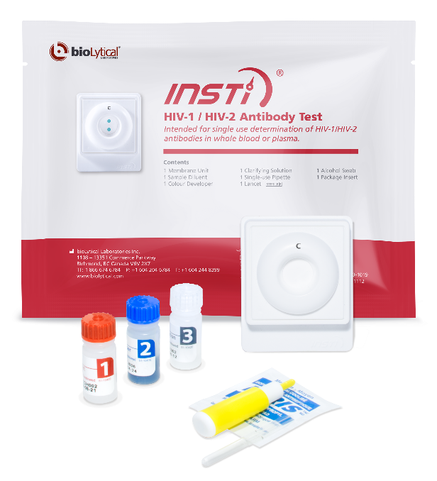
The INSTITM HIV rapid test
MODULE: Performing the INSTI HIV Rapid Test
Licensed in Canada and approved in Ontario for rapid screening
4 steps with all of the necessary materials in one package
Rapid testing:
Provides quick answers for clients, with testing and results in a single appointment
Can be done outside medical facilities by non-medical personnel under a directive from medical personnel authorized to conduct testing.
Notes:
- Introduce the test and review why rapid testing is a valuable part of the Ontario HIV Testing program
- Emphasize that the ability to test outside a lab does not equal lesser standards around quality control and record keeping

Slide 3


The INSTITM HIV rapid test
MODULE: Performing the INSTI HIV Rapid Test
INSTITM HIV Results when testing whole blood
Used as a screening test in Ontario; must be confirmed with standard testing
Measures both IgM and IgG antibodies produced by the human body in response to HIV infection
Highly accurate when antibodies are present (beyond the early window period)
Sensitivity | 99.6
Specificity | 99.3
A sensitive fishing net catches all of the tuna, but perhaps some dolphins….
A specific fishing net catches only tuna and lets the dolphins swim free
An ideal test is sensitive and specific
Notes:
- Emphasize that this is an antibody test –as we learned in the window module, detection early in the window period is the key limit
- Briefly note that the test is both sensitive and specific (but it is not necessary that the participants understand sensitivity/specificity in a technical way)

Slide 4
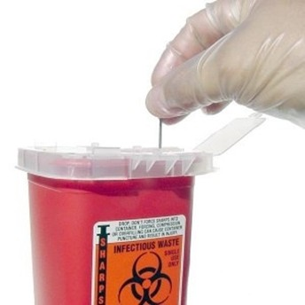
What you need for testing
MODULE: Performing the INSTI HIV Rapid Test
A quiet private place where you can counsel the client, with a level surface where you can do the test (or an adjacent space for you to do the test if that is the practice of your centre)
The INSTITM HIV test kit with all the materials needed for finger prick and the testing
One or more receptacles for biohazardous waste and “sharps.” The waste container for sharp items like the lancet must have hard sides.
Cotton or gauze and band aids for the client
Gloves as well as hand sanitizer or soap
Notes:
- Review the required materials for testing including appropriate means of disposing of sharps and biohazards (they should be checking their environment for appropriate disposal options before they have a bloody lancet in their hand!)
- Talk about gloves, universal precautions and hand hygiene

Slide 5

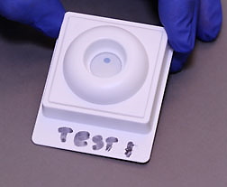
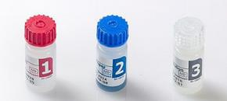
Components of the test kit
MODULE: Performing the INSTI HIV Rapid Test
Product Insert
Lancet
Alcohol swab
pipette
Membrane unit
Test Reagents
Notes:
- Show what is in the test kit, and remind participants about the product insert as a source of info
- Using the vials in the correct order is vital

Slide 6















How it works summary
MODULE: Performing the INSTI HIV Rapid Test
Common HIV-1 HIV-2
antibody
Blue dye from reagent 2
Two spots on the test membrane attract and capture human antibodies (Ab)
  Top control spot captures any human antibody (shows the test is working)
  Bottom test spot captures only antibodies (Ab) to HIV-1 or HIV-2
After capture, the antibodies are stained with a blue dye (blue colour appears where antibodies have been captured)
Capture area on membrane surface
Blue dye from reagent 2
Capture area for HIV-1 and HIV-2 Ab
Notes:
- Some people find this slide difficult both to explain and to understand
- Important messages: 1) The control spot should always react for the test to be valid
2)The test spot only detects antibodies to HIV-1 OR HIV-2; it detects both IgM and IgG antibodies

Slide 7
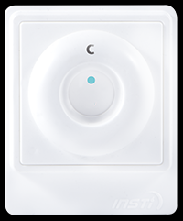
Beginning the Test
MODULE: Performing the INSTI HIV Rapid Test
Watch a video of the testing procedure at
https://youtu.be/7wp1AEVIm50 for more testing tips
After pre-test counseling and gaining the client’s consent for testing, let them know it is time to start the test; wash or sanitize your hands
Collect the materials needed; write the client’s name or ID number on the daily log sheet along with the POC kit lot number and expiry date
Orient the test membrane so the name tab is at the bottom; a small letter C indicates the control spot at the top
Ask the client which hand they would like to use and begin blood collection
Can be used to write the client’s name (or ID #)
Notes:
More details will be provided about logs and reporting forms in a later session; emphasize that completing logs and forms is an essential part of testing, may be done after the test in some centres.

Slide 8

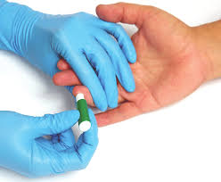
Blood Collection
MODULE: Performing the INSTI HIV Rapid Test
Select the finger for blood collection and massage the finger to warm it and ease blood flow
Clean with an alcohol wipe
Allow alcohol to dry completely
Hold the finger firmly below the top joint
Apply lancet along the side of the chosen finger (as shown), not at the very tip
Release the finger and discard the lancet in the sharps container
Notes:
Mention that the bioLytical video has more detail about blood collection
Note the ideal areas for the puncture
Emphasize the safe disposal of the lancet

Slide 9
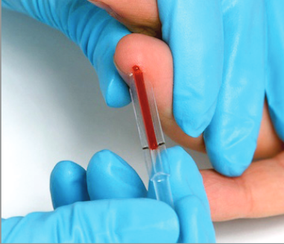
Blood Collection
MODULE: Performing the INSTI HIV Rapid Test
Hold the pipette horizontal, or slightly below; touch it to the blood drop
Gently squeeze the finger
Allow it to fill to the black line, this will happen automatically by capillary action
Don’t squeeze the pipette, and don’t cover the small hole just above the black line while collecting the sample
Give the client a cotton ball or gauze to press to the puncture; make sure they are not feeling faint
Notes:
Suggest keeping the pipette at, or slightly below, horizontal – when you do the blood naturally flows into the pipette; blood does not need to be milked out of the finger into the tube!

Slide 10
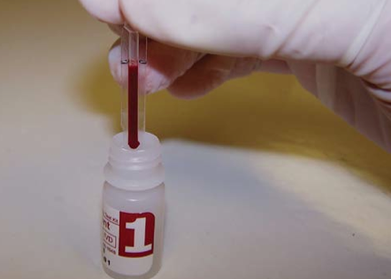
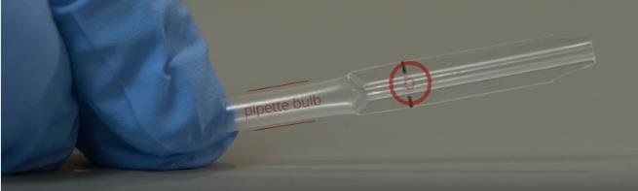
Beginning the Test
MODULE: Performing the INSTI HIV Rapid Test
Add all of the blood to vial 1 (red) by squeezing the end of the pipette
If all of the blood is not expelled, cover the hole just above the black line and try again
Recap the bottle and mix gently by inversion
Offer the client a band aid
Practice differs between clinics; if your clinic does the test out of sight of the client, now is when you should move to another room. You have five minutes to add vial one to the membrane unit.
Notes:
Demonstrate how to use the pipette

Slide 11
Perform the Test
MODULE: Performing the INSTI HIV Rapid Test
Invert vial 1 again, and within 5 minutes, pour the combined contents into the membrane unit
  ….Wait until the fluid has fully soaked in; this gives the antibodies time to attach
Add the contents of vial 2 (blue) to the membrane ….Wait until the fluid has fully soaked in; this allows the blue dye to attach to the antibodies
Add the contents of vial 3 (grey) to the membrane The clarifying solution makes the test dots easier to see clearly; the membrane can be read when it is still wet, and must be read within 5 minutes of adding the clarifying solution
Notes:
- Suggest gently inverting vial 1 again just before the pour if the tester has moved to another room
- Emphasize that the tester does not have to time anything; just wait for one solution to be absorbed and then add the next
- This step-wise process may also help people understand how the test works

Slide 12
Read the Test
MODULE: Performing the INSTI HIV Rapid Test
In Ontario, we report three possible outcomes for an INSTITM HIV rapid test
Always read with the tab down
Check your take home materials for a chart illustrating some real world examples of how tests may appear
Name or ID#
Name or ID#
Name or ID#
Reactive
Non-Reactive
Invalid
Any visible test dot, even if it is faint or hollow, should be considered reactive.
Notes:
- Emphasize that a visible test dot, no matter how faint or indistinct should be interpreted as reactive. In Ontario, we do not use the term indeterminate. We err on the side of caution, and have any possible positive test confirmed with standard testing)
- Highlight and show reference sheet in take home materials (even if other participant materials are available electronically, a printed version of this tool should be available to trainees)

