Slide 1
After completing this unit you will be able to :
MODULE: Quality Assurance and Inventory Management
Understand the purpose of Quality Assurance, the role of the Quality Assurance Lead at your site and how you will support these activities
Understand how test kits are ordered, stored and evaluated; support ordering and inventory management
Perform positive/negative quality control testing of new kits
Understand the ongoing quality assurance processes done at each site and the documentation required

Slide 2


Why is Quality Assurance important?
MODULE: Quality Assurance and Inventory Management
  Ensures that your clients get accurate results and high-quality care
  Ensures that your site is able to perform accurate testing – necessary to maintain approval for testing at your site
  Ensure that all sites in Ontario provide consistent results
  Allows the Ministry to monitor the reliability of the kits it purchases
  All Ontario laboratories perform Quality Assurance testing by law, these procedures have been adapted for point of care testing sites by the Ministry
Notes:
Stress that quality assurance is about providing high quality care
Without quality assurance systems, POC testing sites can not operate in the province

Slide 3



Quality Assurance is Everyone’s Responsibility!
MODULE: Quality Assurance and Inventory Management
HIV test counsellors at your site (like you)
the quality assurance lead at your site
(may be a supervisor or some other designated individual)
the manufacturer
bioLytical Laboratories Inc.
The Ministry of Health and Long-term Care
Notes:
Name the QA lead at your site, so trainees know who to go to

Slide 4

What does Quality Assurance Involve:
MODULE: Quality Assurance and Inventory Management
Training and updating of staff skills
Monitoring of how test kits are ordered, received, stored and used
Regular evaluation of test kits to make sure they are working properly
Regular assessment of the proficiency of the staff and procedures at your site to ensure correct results
In every case, careful record-keeping is essential!
Notes:
Although there is a quality assurance lead, stress that everyone doing testing has a role

Slide 5

Manufacturer
MODULE: Quality Assurance and Inventory Management
The Ministry
Site Supervisor/ QA Lead
IQMH
Institute for Quality Management in Health
HIV Test Counsellor
Initial quality testing of kits
Provides quality control supplies to sites
Provides Certificate of Analysis for kit lots to Ministry
Responds to any concerns related to test performance
Creates training resources & quality assurance direction
First contact for quality issues/ liaison with all
Technical support for investigations
Periodic site audits
Manages online Inventory Management portal for ordering kits, QA supplies, certification panels
Ensure all staff are trained and certified
Oversees the site’s Quality Assurance practices; reviews & approves internal records; takes corrective action as needed
Ensure that the site participates in biannual IQMH PT assessments
Ensures Inventory Management portal is updated regularly
Oversees incident reviews
Participates in training, certification and proficiency testing (PT)
Does positive/negative quality control testing, temperature recording & inventory ordering, as directed
Maintains daily log accurately
Part of incident reviews
Prepares staff certification panels
Runs biannual Proficiency Testing (PT) Assessment
Distributes PT panels
Manages online Qview Web Portal
See the Ontario HIV Testing Program website for a complete table of responsibilities.
Notes:
These are the key players in the Quality Assurance processes at your site
A table of QA responsibilities is available on the HIV Testing Ontario web site
Consider ending your presentation at this point, and having trainees review detailed quality control practices appropriate to their activities at a later time.

Slide 6

Training and Updating of Staff Skills
MODULE: Quality Assurance and Inventory Management
Your Responsibilities
Participate in new staff training, including these training modules, practical training and mentorship at your site, etc.
Complete a certification testing panel after your training is complete to fully qualify as a tester.
Take part in refresher training, after any prolonged absence. Annual refreshers are recommended, particularly for lower volume sites.
Keep track of the records of your training and make sure you submit them to be placed in your HR file.
It is the responsibility of your site and your quality
assurance lead to make sure you are trained appropriately.
Notes:
Training is a responsibility at each site. Even if people shadow at another site, that is not where their training really happens.
Over time these trainees will also become mentors and trainers.

Slide 7

Certification Testing
MODULE: Quality Assurance and Inventory Management
HIV testing sites in Ontario can order certification panels for new HIV test counsellors through the Ministry’s Inventory Management portal. Once you have completed your training, you will participate in this testing.
What happens:
You receive a panel of samples for HIV testing. The panel is prepared by the Institute for Quality Management in Healthcare (IQMH) Neither you, nor anyone else at your site will know what the results of these tests should be.
You will test the samples according to the package instructions and return them to the IQMH.
Results of the testing will be available to the administrators of your testing site and through the Ministry. If your findings were acceptable, you will be certified as an HIV testing counsellor.
Certification panels are not positive/negative quality controls or Proficiency Testing panels. Each of these forms of quality assurance testing has a different purpose and process.
Notes:
Explain when you will begin this process for this/these trainees.

Slide 8

Supplies and Inventory
MODULE: Quality Assurance and Inventory Management
Different supplies are ordered from different locations:
  Inventory Management portal (www.HIVPOCT.ca) – Kits, positive/negative quality controls, and certification panels
  AIDS Bureau – Additional capillary pipettes, bulb pipettes and tracking stickers to prioritize and direct samples referred to the Public Health Ontario Laboratory (PHOL).
  Public Health Ontario Laboratory (PHOL) – Standard HIV Testing Requisition (online) and Anonymous HIV Testing Requisition (by phone)
We’ll talk more about testing requisitions and tracking stickers in the Test Requisition Module.
Notes:
Make clear which individuals at your site, currently do this ordering, and who to talk to if supplies are low.

Slide 9

Inventory Management & Supplies
MODULE: Quality Assurance and Inventory Management
Maintaining supplies and ensuring their quality is one of the primary responsibilities of your Quality Assurance Lead. However it is also useful for you to know how these supplies are managed. Alert the lead about damaged supplies, or low supplies of kits or positive/negative quality controls.
Your site has a secure user name and password for the www.HIVPOCT.ca portal, which is used to manage your inventory. The portal allows your site to:
  Order supplies (kits, positive/negative quality controls, certification panels)
  Confirm shipment of new kits (not necessary for positive/negative quality controls or certification panels).
  Enter kit usage information prior to ordering new kits. The necessary information is collected in the monthly summary done by your QA Lead.
  Review reports of past/current orders and kit usage.
Kit usage reports help the Ministry track how many kits are needed and any problems or errors that may be occurring.
Invalid results should be reported as damaged.
Notes:
Once a new testing counsellor is established and integrated into practice at your site, you may want to orient them to the portal, if they will ever need to cover this responsibility.

Slide 10
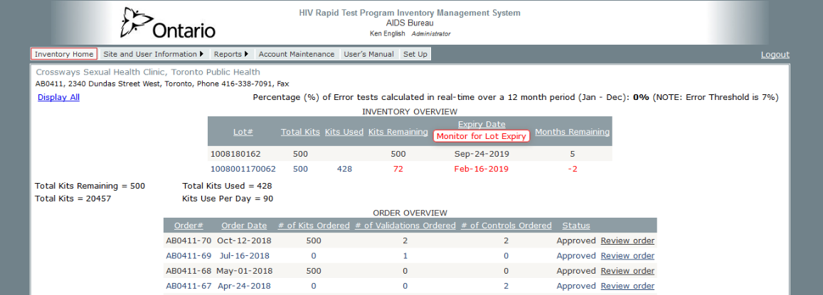
Inventory Management Portal
MODULE: Quality Assurance and Inventory Management
When 500 new kits were ordered in Oct; 72 of the old lot remained. These are flagged as approaching expiry. Usage of kits will have to be updated before any new kits can be ordered
Your Clinic & Address
Summary stats about kit use at your clinic
Kits, Controls, & Certification Panels last ordered Oct 12, 2018
Notes:
Included primarily to give frontline counsellors an idea of the detail tracked

Slide 11

Test Kits – Receiving an Order
MODULE: Quality Assurance and Inventory Management
Make sure that new orders of test kits are stored in the storage area away from any existing kits, until they can be tested with positive/negative quality controls; all existing lot of kits should be used before starting the new ones.
Check to make sure the new kits have not been frozen or damaged.
If asked to do so by the Quality Assurance Lead, test new kits with the positive/negative quality controls
Ensure that new kits are not left unattended and that you know who to notify about a new shipment.
Your site is responsible for maintaining an ongoing inventory of your kits at www.hivpoct.ca.
Notes:
Make sure that the trainees know where and how kits are stored at your site.
Make sure trainees understand where the kit lot number is on the package. While individual components of the kit also have lot numbers only this kit number needs to be recorded. This information must also be added to the inventory management system used to order kits from the Ministry.

Slide 12


Test Kits – Storage of Kits
MODULE: Quality Assurance and Inventory Management
Test kits may be stored in a refrigerator or at room temperature, as long as the temperature never exceeds 30° C. The temperature must be recorded daily and range between 2-30° C.
  Your temperature gauge should record the high and low temperature each day as well as the current temperature
  Because low temperature storage is acceptable, kits can be refrigerated to protect them in hot environments. When kits are being moved to an outreach site, be aware of the temperature; kits should never sit out in the sun, or be left in a car trunk in winter.
If a temperature outside 2-30°C is recorded, quality control testing of all stored lots must be done, before further client testing can continue.
The store room temperature must be checked daily
Notes:
Show the trainees the temperature log, and where to get more pages if needed.

Slide 13
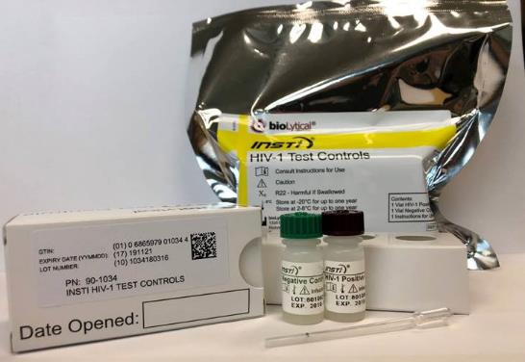
Evaluating Kits with Positive/Negative Quality Controls
MODULE: Quality Assurance and Inventory Management
Your site should have two vials of quality control material: one HIV-positive and one negative. The positive control is only weakly positive. A reactive test demonstrates that the kits at your site are working in an optimal way. Controls are ordered at www.hivpoct.ca.
Control testing should be done:
When the kits are first received before any kits are used (this is sometimes referred to as validating the kits)
If a temperature reading is recorded outside the 2-30°C range
Monthly on existing kits or every 125 tests completed (not more than once a week for high-volume sites)
Controls may be kept frozen or refrigerated for up to a year. Which ever way they are stored, use the expiry date as written!
Notes:
Talk about how the responsibility for positive/negative quality control testing is done at your site. Does the QA Lead do it or assign it to others?
Where and how are the materials stored. Whether the controls are stored in the fridge or freezer – the expiry date remains the same. Show the trainees the samples and package insert.

Slide 14
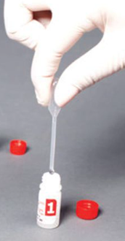
Evaluating Kits with Positive/Negative Quality Controls
MODULE: Quality Assurance and Inventory Management
Take two test kits from the lot you are testing, unwrap the first kit and open vial one as normal
Use a bulb pipette to withdraw 50 µl of control from the negative control (up to the pipette’s black line), and add it to vial one; complete testing as normal
To test the second kit, use a different bulb pipette to withdraw 50 µl of control from the positive control, and add it to vial one; test as normal
It is recommended that the results be recorded on both the Daily Log and the Quality Control Log
Notes:
Assuming the that trainees may be doing this testing, talk a little bit about the challenges of using the bulb pipette and how it is different from the one used with patients. Let them practice with water or tea.

Slide 15

What if Positive/Negative Quality Control Testing fails?
MODULE: Quality Assurance and Inventory Management
Immediately
If the positive is not positive, or the negative is not negative, don’t discard the test material (membrane, etc.) Take a picture. Both may be used to investigate.
Alert the Quality Assurance Lead and/or Supervisor (not required at all sites).
Record what happened in the incident log including the expected result, the result obtained and subsequent efforts to resolve the cause of this incident.
Second Test
Repeat the testing a second time using the same lot of test kits and the same controls. Tests of each control should be done one at a time, not simultaneously.
If the results are acceptable (as expected), record them in the quality control log and incident log. Testing at your site can continue as usual.
Try to identify why the first test came out wrong (i.e. mix up of materials or a missed step) Record in the incident log.
The failure of two sequential QC tests is cause for serious concern.
Notes:
Often a one-time unexpected result, will be an error in how the test was done (the cause is due to the actions of the tester). It needs to be reported on the incident log, and why it happened needs to be sorted out, but it is not a crisis, and will not affect testing at your site.
Show trainees where to find the incident log and how to fill it out.

Slide 16

If two quality control tests have failed:
MODULE: Quality Assurance and Inventory Management
Have the quality assurance lead conduct this testing whenever possible.
Test again (3rd test) using a different lot of quality controls
3rd test produces acceptable result; do a fourth test with the same newly-opened quality controls
3rd test result is un-acceptable
(unexpected or invalid result)
All testing at your site must stop. Notify the AIDS Bureau Immediately. An investigation must be conducted.
4th test result is acceptable. The problem was with the controls. Record in the incident log and order new control.
4th test result is un-acceptable
(unexpected or invalid result)
Notes:
If a problem happens on multiple tests, the problem is more likely with the materials and needs to be resolved, so that HIV test services are not compromised for your clients, and those at other sites
If testing needs to be suspended at your site, it is in no way the tester’s fault. Impress on the trainees, that this is an unlikely chain of events.

Slide 17

Test Kits – Use of Kits
MODULE: Quality Assurance and Inventory Management
Record the lot number and expiry date of every kit that you use in the daily log
Do not switch back and forth between different lots of kits. The first kits to arrive should be used first
Check each kit before use to make sure it has not been damaged
bring damaged kits to the attention of the Quality Assurance Lead.
Positive and negative quality control need to be used regularly!
If a kit does expire, it is sterile. It can be placed in the regular garbage. Please do not use clear garbage bags.
Notes:
These trainees will use the daily log every day as part of both test reporting and quality control. We talked about it in the test requisition module, but you may want to reiterated where it is, and talk specifically about how proficiency/QC/practice kits are entered.

Slide 18

Test Kits – Use of Kits
MODULE: Quality Assurance and Inventory Management
What if a kit produced an invalid/unreadable test result when testing a client?
When invalid tests happen, don’t discard the testing material (membrane, etc.)
Do a second test
If the 2nd test is valid
If the 2nd test is invalid
Record the first and second results in the daily log; counsel the client as normal based on the 2nd test.
Record the first result in the incident log, and carefully consider what may have caused it.
Recommend the client have a standard test. With client consent, draw blood for the testing.
Record the results of both tests on the daily log along with the referral to PHOL.
Record both tests in the incident log, and report to the QA Lead for investigation.
Whenever an invalid test happens, take a picture. This photo should be sent to the AIDS Bureau.
Notes:
The facilitator needs to explain how this will fit into the processes in place at your site. For example, are two people looking at every test result? If not, when an invalid result happens you might want to recommend they find a second counsellor to be available to read the second test with them.

Slide 19
Assessing Testing Processes at Your Site
MODULE: Quality Assurance and Inventory Management
Rapid testing sites are also expected to evaluate their staff and procedures regularly as follows:
Parallel Testing – Every time a reactive test occurs, clients are advised to confirm the result with standard laboratory testing. This also helps ensure that testing is working well at your site. Report to your Quality Assurance Lead whenever follow-up testing on a reactive rapid test is non-reactive or when a negative sample submitted for standard testing in the window period has a reactive result.
Monthly Assessment of Testing Results – Each month, your Quality Assurance Lead completes a monthly summary of testing at your site including the number of positive, negative and invalid tests done, the number referred to PHOL for further testing, any unanticipated results and kit usage. This information is gathered from the daily log.
Proficiency Testing (next slide)
Notes:
These are the ways that the Ministry monitors outcomes at each site and the quality of POC testing across the province.

Slide 20

Proficiency Testing (PT)
MODULE: Quality Assurance and Inventory Management
The Ministry has established a regular Proficiency Testing Program for rapid
testing sites, administered by the Institute for Quality Management in Healthcare (IQMH).
  Your site will regularly receive unknown samples from IQMH to test and return for assessment.
  Each of the people who provide testing for clients at your site should participate.
  When the results have been analyzed they will be available through the secure Qview portal managed by IQMH. Your Quality Assurance Lead will have access.
The Ministry monitors the outcomes of this testing, to ensure that errors are investigated and corrective action taken, as needed.
NOTE: Proficiency Testing (PT) samples are NOT positive/negative quality controls or certification panels. Ensure that each package is handled correctly.
Notes:
Talk about how this task rotates at your site. Stress the importance of completing and returning this testing to IQMH in accordance with the package instructions.

Slide 21

Summary of Required Logs and Documentation
MODULE: Quality Assurance and Inventory Management
Daily tools that all staff interact with and use regularly
Rapid HIV Testing Record Daily Log
Environmental Monitoring Log
A monthly summary usually done by your site’s Quality Assurance Lead
Records kept as the activities occur
Quality Control Log
Incident Log
Proficiency Testing Records
Records of Counsellor Training and Certification
These documents might be requested, if an investigation at your site occurred
There is a brief description of each document in your handout; All documentation is stored for 10 years.
Notes:
Review where each of these logs can be found at your site. Links to the templates for each are available on the testing website.

