Slide 1
After completing this unit you will be able to :
MODULE: Assessing HIV Risk
Understand the balance of partners, practices and protections, when assessing HIV risk
Ask clients about their reasons for testing and their risk behaviours in a respectful way
Adapt counselling to the needs of the individual testing
Outline Ontario’s guidelines about appropriate frequency of HIV testing
Notes:
Review the learning objective with the trainees

Slide 2
This module focuses on the second stage of testing:
MODULE: Assessing HIV Risk
Introducing the testing conversation
Assessing risk and the client’s service needs
Explaining the test and obtaining consent
Performing the test
Providing follow-up support around the test results and referral to services
ARCCH
As for all testing discussions, your approach should be
Adapted to client needs, Respectful and non-judgemental, Confidential, Consenting and part of linking the client to a continuum of High-quality services
Notes:
Review the learning objective with the trainees

Slide 3
MODULE: Assessing HIV Risk
MODULE: Reasons and Risk
When should a person be tested for HIV?
A person should be tested for HIV whenever they have had one or more high-risk exposure(s) to HIV.
There are three elements to weigh when determining the degree of HIV risk a client has encountered: partners, practices and protections
Not every high-risk exposure will result in HIV infection, but testing should be recommended after any high-risk exposure.
Notes:
Note that you will talk about detectable/undetectable in a moment.

Slide 4
Assessing Risk
MODULE 2: Assessing HIV Risk
Assessing risk means working with clients to understand the balance of the three Ps: partners, practices and protections.
Partners
Practices
Protections

Slide 5
What is a high-risk exposure?
MODULE 2: Assessing HIV Risk
For an exposure to be high risk, all three of the following conditions must be true:
Partners: The client’s sexual partners are HIV-positive (or may be HIV positive), and may have detectable levels of HIV; sharing of needles and other equipment should always be considered a risk of the drug-use partner(s) may be HIV-positive
Practices: The client and their partner(s) were involved in practices that exchanged blood, semen, rectal fluid, vaginal fluid or breast milk
Protections: There may have been gaps in the prevention strategies the client used for protection from HIV infection
There is no HIV risk, if an exposure does not involve partners, practices and gaps in protection that can put the client at risk.
Notes:
Note that you will talk about detectable/undetectable in a moment.

Slide 6
Partners
MODULE 2: Assessing HIV Risk
Often clients cannot be sure of the HIV status of their partner(s). However, we know that the people living with HIV in Ontario, are almost all part of one of these five population groups. The percentage of new diagnoses from each of these groups is shown (2017):
gay, bisexual and other men who have sex with men, including trans men (54%)
African, Caribbean and Black (ACB) communities—including men and women from regions where HIV is endemic (29%)
Indigenous peoples (3%)
people (men and women) who inject drugs or share drug equipment (10%)
women* = cis and trans women, including women from the above populations, and other women who face systemic and social inequities, and are more likely to be exposed to HIV through a sexual or drug using partner (21%)
These groups are the focus of Ontario’s HIV prevention and testing programs – and are referred to as priority populations. It adds up to more than 100%, because some people are identified as part of more than one group.
Notes:
Perhaps say something about stigma and the importance of recognizing and responding to the high prevalence of HIV in these populations without further stigmatizing them.

Slide 7
Partners
MODULE 2: Assessing HIV Risk
* Only five body fluids can contain enough HIV to pass the infection: blood, semen (including pre-cum), rectal fluid, vaginal fluid and breast milk
To pass HIV to another person, someone must:
Be infected with HIV (be HIV-positive)
Have a high enough concentration of HIV in their body fluids* to infect someone else
Even with the consistent use of an effective antiretroviral drug, the time to reach undetectable varies (typically 2-5 months.) The best outcomes are reported for people who begin treatment within a few days of their diagnosis, making linkage to care a vital part of the testing process.
Treatment
Both time and treatment affect the amount of HIV in the body of an HIV-positive person; but without treatment transmission is always possible
Amount of HIV
Becomes Undetectable
Time
Notes:
This is one possible treatment curve for HIV infection. Some people are not able to become undetectable. Some delay their treatment or go on or off treatment.
See data from the RAPID study as published by CATIE with regard to the time to undetectable. https://www.catie.ca/en/pc/evidence-briefs/rapid

Slide 8
Partners
MODULE 2: Assessing HIV Risk
What does undetectable/detectable mean?
Undetectable means that HIV treatment has reduced the amount of HIV in a person’s blood below the level that a viral load test can measure. The person is not cured, but if they continue treatment, HIV will cause little harm to their body. Someone can not pass HIV to another person sexually if they have been undetectable for six months. The transmission risk of needle sharing is also reduced.
Detectable means that the number of copies of HIV in a person’s blood can be count with a viral load test. When HIV can be detected, HIV is replicating in a person’s system and that their health may be at risk.
HIV-positive people who consistently take antiviral treatments are protecting their own health AND others.
U=U
Undetectable = Untransmittable
The U=U slogan celebrates the fact that effective HIV treatment makes it impossible for an undetectable person to infect anyone else through sex
Notes:
U=U is a relatively new understanding. Some clients and some of their partners may not understand it, so it is good to reiterate with clients as appropriate. It is equally important to stress that undetectable is not a permanent status, it is dependent on people continuing successful treatment.

Slide 9
Partners
MODULE 2: Assessing HIV Risk
HIV Status and Serosorting
Serosorting means choosing ones sexual partners based on their HIV status (negative or undetectable)
Serosorting is based on facts:
An HIV-negative person cannot transmit HIV
An HIV-positive person who is undetectable cannot transmit HIV
… however, particularly with casual partners, it also raises challenging questions of trust and truthfulness.
The Challenge of Being Sure
If a potential partner tells you that they are HIV-negative or undetectable is that enough? People often assume they know their HIV status but haven’t been tested recently. Others may not fully understand the terms they use. We all want to trust each other – but if a client cannot be sure that there is no risk, advise them to test.
The basic rule for counselling: If the client can’t be sure, recommend testing!
Notes:
U=U is a relatively new understanding. Some clients and some of their partners may not understand it, so it is good to reiterate with clients as appropriate. It is equally important to stress that undetectable is not a permanent status, it is dependent on people continuing successful treatment.

Slide 10
Partners
MODULE 2: Assessing HIV Risk
In Summary:
An HIV exposure may be high-risk if:
A client’s partner(s) are HIV positive, and the client can not be sure that their viral load is undetectable
The client and/or their sexual partners are members of one of Ontario’s priority populations and the client has one or more partners whose HIV status they don’t know
Partners
Practices
Protections
Remember: assessing risk is a balance. The status of a client’s partners only matters if they are engaged in high risk practices or there are gaps in their protections.
Notes:
Only priority populations (or people whose partners and known HIV-positive/ members of priority populations), can by definition have high risk exposures

Slide 11
Practices
MODULE 2: Assessing HIV Risk
Whether or not a person has had a high risk exposure also depends on their practices. There is never any risk in touching, hugging, sharing food or mutual masturbation with an HIV-positive person, regardless of the amount of virus in their body.
The following activities are high risk, if a person’s partner(s) were HIV positive with a detectable viral load and no precautions were taken to avoid sharing body fluids:
Anal sex - both receptive and insertive sex
Vaginal sex - both receptive and insertive sex
Sharing needles, or other equipment to inject or inhale drugs
Sharing sex toys inserted into both bodies without washing in between and no condom use
Notes:
These are the activities that are more likely to lead to high risk exposures, but there are a few other possibilities (ie. sharing tattoo equipment outside a sterile setting, a blood transfusion in a region where blood may be screened less effectively than in North America). Feel free to add any factors that may be a concern at your site.

Slide 12
Practices
MODULE 2: Assessing HIV Risk
All high risk practices are not equal, here are some estimates of the risk associated with each act with a detectable HIV-positive partner:
Act | Likely Rate of Transmission per Act
Receptive Anal Sex (someone penetrated the client) | 1 transmission / 71 acts
Injecting drugs with a shared needle | 1 transmission / 159 acts
Insertive Anal Sex (the client penetrated someone else) | 1 transmission / 909 acts
Receptive Vaginal Sex (someone penetrated the client) | 1 transmission / 1250 acts
Insertive Vaginal Sex (the client penetrated someone else) | 1 transmission / 2500 acts
These risks are often lower than people expect, however even a single one of these acts will sometimes result in an HIV infection
Check your participant’s handout for detailed resources about the relative risk of different activities including the source of this table!
Notes:
Make sure participants have accessed their trainee handout for this unit. That is where the details are!

Slide 13
Practices
MODULE 2: Assessing HIV Risk
Partners
Practices
In summary:
Focus on how the person has sex when discussing practices
Only activities that exchanged blood, semen, rectal fluid, vaginal fluid or breast milk can transmit HIV
Protections
Remember: High risk practices, such as anal sex, can only be high-risk exposures, if a client’s partner is potentially HIV-positive and detectable, and if there are potentially gaps in the client’s prevention strategies.
Notes:
Make sure participants have accessed their trainee handout for this unit. That is where the details are!

Slide 14
Protections
MODULE 2: Assessing HIV Risk
HIV infection can be prevented by avoiding contact with the blood, semen (including pre-cum), rectal fluid, vaginal fluid and breast milk of anyone who might be infected.
Protective Strategies:
Abstinence/Low Risk Sex – avoiding activities that exchange these fluids by only engaging in no-risk or low-risk activities such as oral sex or mutual masturbation
Harm Reduction – using clean disposable products to inject or inhale drugs: to avoid HIV infection needles, cookers, water and filters, as well as pipes and stems, must not be shared
Condoms – using condoms every time there is penetrative sex
PrEP (Pre-Exposure Prophylaxis) – taking antiviral drugs regularly to prevent infection
Notes:
PrEP was discussed in the last unit; remind if needed

Slide 15
Gaps in Protection
MODULE 2: Assessing HIV Risk
Possible Strategies:
Abstinence/Low Risk Sex
Harm Reduction
Condoms
PrEP (Pre-Exposure Prophylaxis)
Help clients think about gaps when assessing risk. Has a client ever had a condom slip off or had a partner stealth* them? Did they ever wait to put the condom on? Do they ever miss one of their PrEP pills? Might they have forgotten about sharing a needle when they were high?
* Stealthing = a partner covertly removed the condom, when only condom-protected sex has been agreed to.
Each of these strategies work!
When talking with clients it is important that you acknowledge the positive things clients may be doing to protect their health. However sometimes gaps occur.
Notes:
It is important to support the good things people are doing to support themselves, and to not be accusatory if people are doing these things only “most of the time.” This is something to be explored in the role plays.

Slide 16
Protections
MODULE 2: Assessing HIV Risk
In summary:
People can protect themselves against HIV infection: condoms, PrEP and limiting their sexual practices to low-risk exposures work, as does harm reduction around drug use
…. however gaps can occur in any of these prevention strategies. Some gaps to ask about are included in your handout.
Partners
Practices
Protections
Remember: A broken condom or other protection gap can only lead to a high-risk exposure when a client’s partner is potentially HIV-positive and detectable, and when their practices together may expose your client to blood, semen, rectal fluid, vaginal fluid or breast milk.
Notes:
Make sure participants have accessed their trainee handout for this unit. That is where the details are!

Slide 17
Conversations about Risk – General Approach
MODULE 2: Assessing HIV Risk
Follow the client’s lead. Start with why they came for HIV testing.
Try mirroring the client’s language. Be aware of the words that they are comfortable using to describe their sexual activities and relationships; try to use similar language.
Ask questions and present information in a relaxed, non-judgmental way, which suggests that others can and do disclose to you (e.g. Other guys have told me..) Keep your language as simple as possible.
Be supportive of client’s strategies for reducing their risks, even when suggesting additional precautions.
Don’t make assumptions; people can have more than one risk factor!
Notes:
If there are particular issues that commonly impact clients at your site, now is time to raise them (e.g. cultural taboos around particular topics for a cultural group)

Slide 18
Intake Forms
MODULE 2: Assessing HIV Risk
Many clinics have an intake form for people coming forward for HIV and other testing (a model intake form is available for download on the HIV Testing site, if needed)
An intake form can provide some information for you to get started on your conversation, help you identify members of priority populations and learn about a client’s past/current use of services (testing/PrEP/PEP)
Some intake forms have checkboxes to help you record what you talk about
An intake form can also help you complete some of the basic demographic information required by the laboratory requisition forms
Get familiar with the intake form used at your site
Notes:
Show the trainees the intake form used at your site and review its content. It is a best practice to not have clients put their name on these intake forms, which ask sensitive questions – although the intake form may be added to a nominal file.

Slide 19
Starting the Conversation – Possible Questions
MODULE 2: Assessing HIV Risk
The Starting Point
Thanks for coming in. What made you come in today? Did something happen that worries you?
The checklist (included in your last handout) suggests questions around partners, practices and protections – and how to go more in-depth around issues like:
HIV-positive partners
Sexual risks
Drug use
Role-playing possible conversations and shadowing your colleagues are the best ways to learn.
Look in your handout for some frequently used phrases!
Condom Use and PrEP
Window period testing
The checklist is a resource to help you cover all the material, but counselling is a conversation. Let the client’s needs guide the flow of your conversation.
Notes:
These are starting questions not the whole conversation. Use the role-play activity to explore issues for clients typically seen at your site.

Slide 20
Risk and Violence
MODULE 2: Assessing HIV Risk
Violence and abuse can make it more difficult for a person to reduce their risks and may be revealed during the course of your risk assessment.
Remember: exposure to HIV may have occurred in the context of trauma. For example, someone sexually assaulted in a conflict zone, may not view this as sex, and may not be able/willing to talk about the details of the exposure.
If a client reveals abuse or violence acknowledge how difficult this experience must have been, and your support (I’m sorry that happened to you).
Offer resources. Know the services in your area, and offer to connect clients to support around leaving an abusive partner or dealing with an assault.
Whenever possible, help the client make contact with needed resources. Offer to call the recommended service provider and set up an appointment.
Learn about and practice trauma aware care.
Any client could have a history of trauma.
Notes:
Tell trainees about local service providers and where to find this information.

Slide 21
Testing after a Sexual Assault
MODULE 2: Assessing HIV Risk
HIV testing is appropriate.
Don’t press a client to reveal specific risks, but if they wish to, you may be able to help reassure them about the relative risks (e.g. If he didn’t penetrate you the risks of HIV infection are low.)
If you are seeing the client within 72 hours of an assault, suggest the option of post-exposure prophylaxis (PEP) and refer to this service if requested. PEP is provided without cost to sexual assault survivors. Plan B to prevent pregnancy can also be suggested.
Connect the client to additional resources including sexual assault services, mental health supports, STI screening or pregnancy testing, if appropriate.
Notes:
How does your site work with the police and local sexual assault services. If procedures are in place tell the trainees!

Slide 22
Risk and Drug Use
MODULE 2: Assessing HIV Risk
Some drug use is illegal/stigmatized; focus on transmission risk. Acknowledge that many clients protect themselves, while continuing to use illegal drugs (e.g. It is great that you regularly exchange supplies at [your local needle exchange].)
Ask about needle use with any drugs, regardless of their legal status (steroids/hormones); use the Ontario Harm Reduction Distribution Program website to help people find clean needles locally.
Ask about sharing of cookers, filters, water as well as needles and about sharing pipes/stems for inhalation; sharing any of these items is a high-risk exposure.
Offer information about useful harm reduction and social services; ask if they need support around problem drug use and refer to addictions services, if requested.
Remember: Some drug use, particularly stimulants like crystal methamphetamine, can also promote sexual risk taking (i.e. risks may be intertwined; ask about both)
Notes:
Talk to your trainees about harm reduction and also addiction services in your area. They should be able to be a link for clients who use drugs. Particularly, if they are likely to see multiple such clients, it is important to role play about appropriate conversations with these clients.

Slide 23
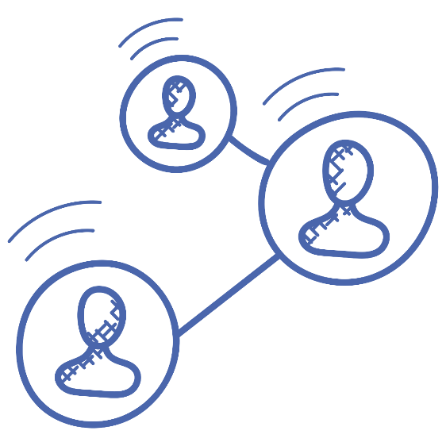
Service Referrals – Continuum of Care
MODULE 2: Assessing HIV Risk
Talking about risk helps you make recommendations for testing, but it also presents opportunities to connect clients to a continuum other services, including both sexual health services and social services. For example:
Sexual Health:
Post-exposure prophylaxis (PEP) for a recent exposure (last 72 hours)
HIV risk reduction programs for specific populations (often offered by AIDS Service Organizations )
Pre-Exposure Prophylaxis (PrEP) for people taking ongoing risks
Screening for other sexually transmitted infections (STI), if not offered at your site. For example:
Recommend syphilis testing for men who have sex with men
Recommend hepatitis C testing for people who use drugs
Referrals aren’t just for HIV-positive clients; at-risk clients need your help too!
Notes:
Show trainees where to access information about referral services. This is an increasingly important part of HIV test counselling. If your site does not keep lists of local service providers and their programs you should consider doing so.

Slide 24
Service Referrals
MODULE 2: Assessing HIV Risk
Examples:
Social Services, Addictions and Harm Reduction:
Services to help clients deal with abuse and sexual assault
Harm reduction services for people using drugs –not just needles!
Addiction services for those dissatisfied with their drug use;
Mental health services if clients disclose struggles;
Social services to deal with housing or other challenges, as well as sources of
additional medical care, if needed.
Harm reduction can also include Party n Play kits for those using meth or education around safer drug use.
Know the services in your area. When possible, help clients find what they need!
Notes:
Show trainees where to access information about referral services. This is an increasingly important part of HIV test counselling. If your site does not keep lists of local service providers and their programs you should consider doing so.

Slide 25
Testing Recommendations
MODULE 2: Assessing HIV Risk
Encourage testing for clients who’ve had a high-risk exposure since their last test
For follow-up of a recent exposure recommend clients return for testing at 3 weeks, six weeks and three months (3-6-3 testing); the scientific basis for this schedule is addressed in a future unit.
For exposures in the past 3-4 weeks, advise standard testing (sent to the public health laboratories) in conjunction with rapid testing
Date of possible exposure
3 weeks
Include standard lab test
6 weeks
3 months
If a client has had only protected exposures, or only participated in low risk practices (i.e. oral sex) advise them that their risk is low. Test, however there is no need for follow-up 3-6-3 testing.
Notes:
This recommended schedule will be discussed in detail in the module on the Science and Practice of HIV testing.

Slide 26
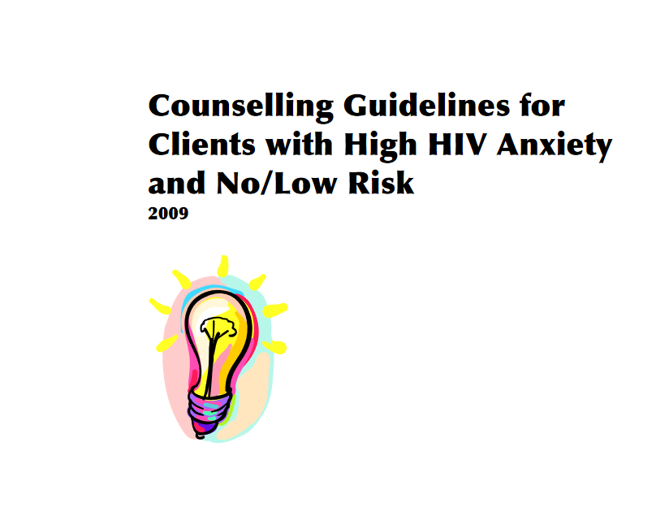
Testing Recommendations
MODULE 2: Assessing HIV Risk
If a client is routinely returning for testing without any significant risk:
Tell them they are not at risk, but don’t repeat endlessly
Acknowledge their feelings, listen to their perceptions
Talk about what is making them feel anxious, and refer them to additional counselling as possible
Use your judgement about performing the test. It is OK to do a test if desired, but to avoid fueling a cycle of anxiety, it may some-times be appropriate not to do requested testing for these clients.
Counselling guidelines are available for high anxiety clients, check your handout for where to find them if needed.
Notes:
Talk about how counselors at your site deals with client anxiety and the resources available

Slide 27
Ongoing Testing
MODULE 2: Assessing HIV Risk
Clients from priority populations who had any risk exposures (even ones where protections were used) should be advised to return for testing annually;
Clients should be advised to test on the 3-6-3 schedule after any high-risk exposure; however if such exposures are happening too frequently to make this feasible for them, suggest testing as often as possible, at least every 3 months; encourage consideration of PrEP.
Clients with no risk exposures do not require routine testing unless their risk behaviours change.
Notes:
If express testing services are offered at your site, explain in more detail about your procedures

Slide 28
Express Testing
MODULE 2: Assessing HIV Risk
Clients who test routinely know their risks and understand the testing process; for these clients, some sites offer express testing services
In an express appointment, discussions of risk and of the test process may be minimal
Consent is still necessary from these clients; as well as confirmation that they have considered who will support them in the event of a positive test
Express options are also becoming an option for sexually transmitted infection (STI) testing. For example, Toronto Public Health offers Easy Screen STI testing for some clients without symptoms.
Notes:
If express testing services are offered at your site, explain in more detail about your procedures

Slide 29
Summary: Pre-test Counselling
MODULE 2: Assessing HIV Risk
The first three stages of testing are often referred to as pre-test counselling. In Ontario’s testing program these steps must be
Introducing the testing conversation
Be welcoming and non-judgmental, take direction from the client’s needs
Assessing risk and considering service needs
Ask risk questions in a non-stigmatizing, conversational way; identify opportunities for needed service referrals
Explaining the test and obtaining consent
Verbally confirm consent; ensure the client understands the consequences of testing and has considered the possibility of a positive test; get them to think of someone in their life that would support them
ARCCH
Key information for each of these stages is indicated on the checklist
Notes:
Summarize pre-test counselling – invite questions
Note that trainees will have opportunities to learn about these skills through shadowing and role playing

